Slide 1

Unconscious Bias
Conference of Colleges Diversity Fund Project on special dietary requirements of BAME and observant religious students
The Listening Brain, Source: The Wellcome Institute

Slide 2
Therapeutic eating
Module 3

Slide 3

Your Name Here
Your College Here

Slide 4

INTRODUCTIONS
Your name and what you do
How long you have done it?
Why are you here?
Why do you want to be a trainer on this subject?
Notes:
4

Slide 5


Domestics
Respectful use of phones please
Emergency evacuation
Toilets
Refreshments

Slide 6


Slide 7
What would you hate to Give up?
Your Favourite Food

Slide 8
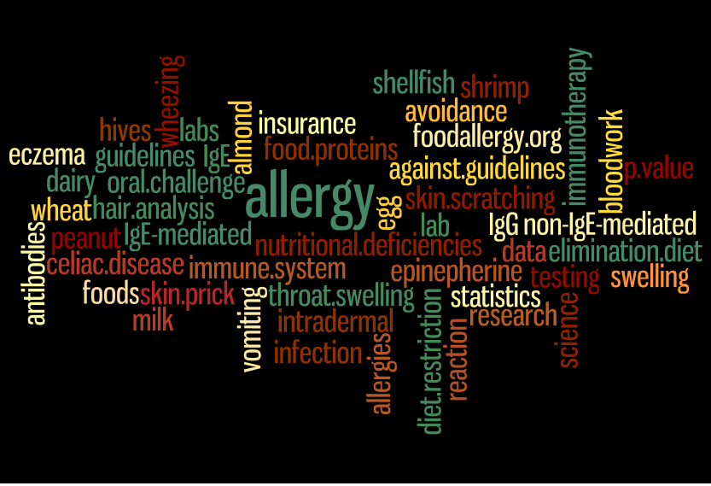
Therapeutic Diets: An Overview

Slide 9
What is An Allergy?

Slide 10

Types of food allergy 1
IgE-mediated food allergy
the most common type
triggered by the immune system producing an antibody called immunoglobulin E (IgE).
Symptoms occur a few seconds or minutes after eating.
There's a greater risk of anaphylaxis with this type of allergy.

Slide 11

Types of food allergy 2
Non-IgE-mediated food allergy
These allergic reactions aren’t caused by immunoglobulin E
But by other cells in the immune system.
This type of allergy is often difficult to diagnose
as symptoms take much longer to develop (up to several hours )
Coeliac Disease is a Non-IgE condition

Slide 12
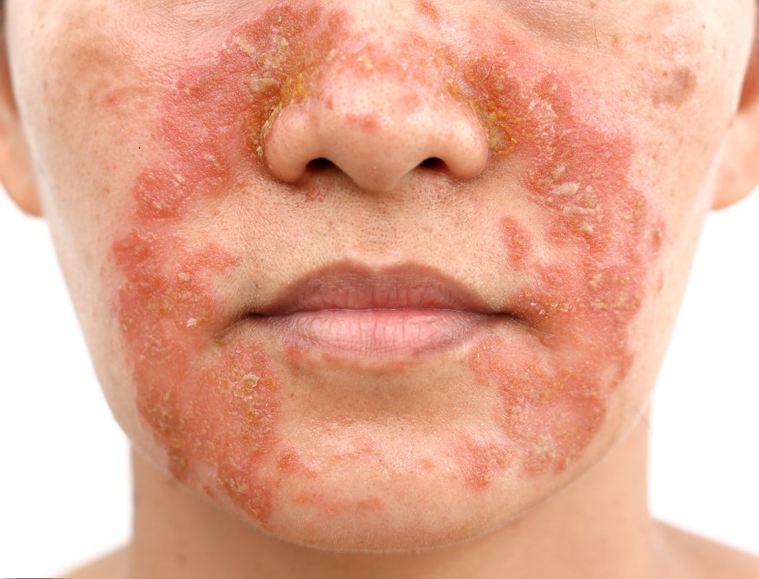
Types of food allergy 3
Mixed IgE and Non-IgE-mediated food allergy
Some people may experience symptoms from both types
Atopic Dermatitis is an example
Notes:
Atopic Dermatitis is where thskin comes into contact with something and responds with Hives and rashes.

Slide 13
Food Allergies - to sum up
Caused by the Immune System
Sees the protein component of a food as a threat
Often a very quick response
Gut related symptoms may take several hours to develop
Children under 5 most likely to develop allergies
85% of what they react to are:
  Cow’s Milk
  Eggs
  Peanuts
  Tree Nuts
  Soy
  Wheat
  Fish
Allergies to Nuts and Seafood produce the most severe reactions
Usually persisting for life

Slide 14
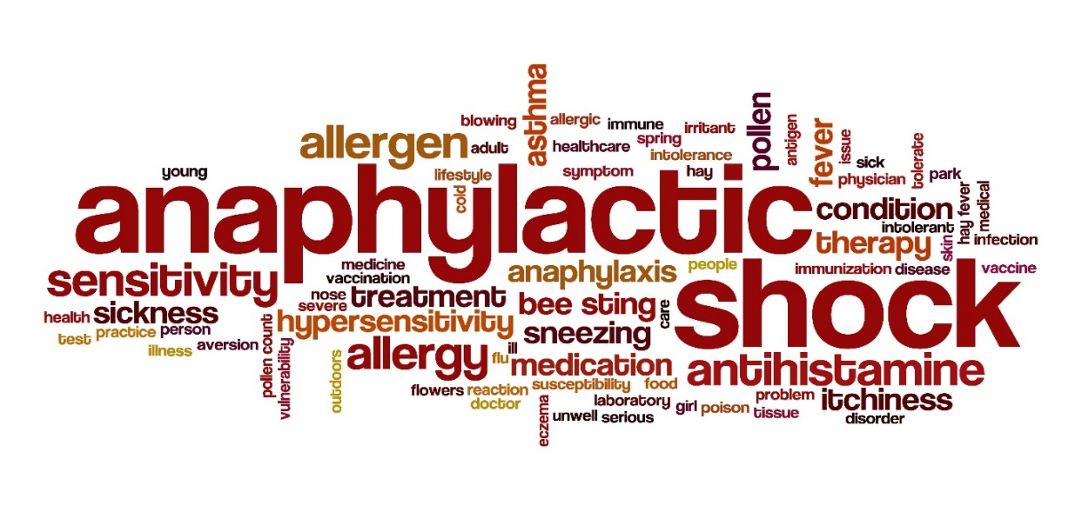
Anaphylaxis 1
A serious allergic reaction to a foreign substance:
  Food
  Medical Treatment
  Venom (e.g. Bee stings)
Studies show that people with Atopic diseases (Asthma, Eczema etc) have a higher risk factor for anaphylaxis

Slide 15
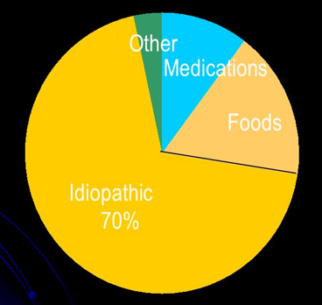
Anaphylaxis 2
Other factors include:
Biological:
  Semen
  Latex
  Hormonal
Food Additives:
  Mono-Sodium Glutamate
  Food colourings
Physical:
  Exercise (usually linked to another factor)
  Temperature – Hot or Cold
Idiopathic = Unknown = 70%
Causes of Anaphylaxis in Adults
Notes:
Sources are Wikipedia
Webb, et al. J Allergy Clin Immunol. 2004, 113:241

Slide 16
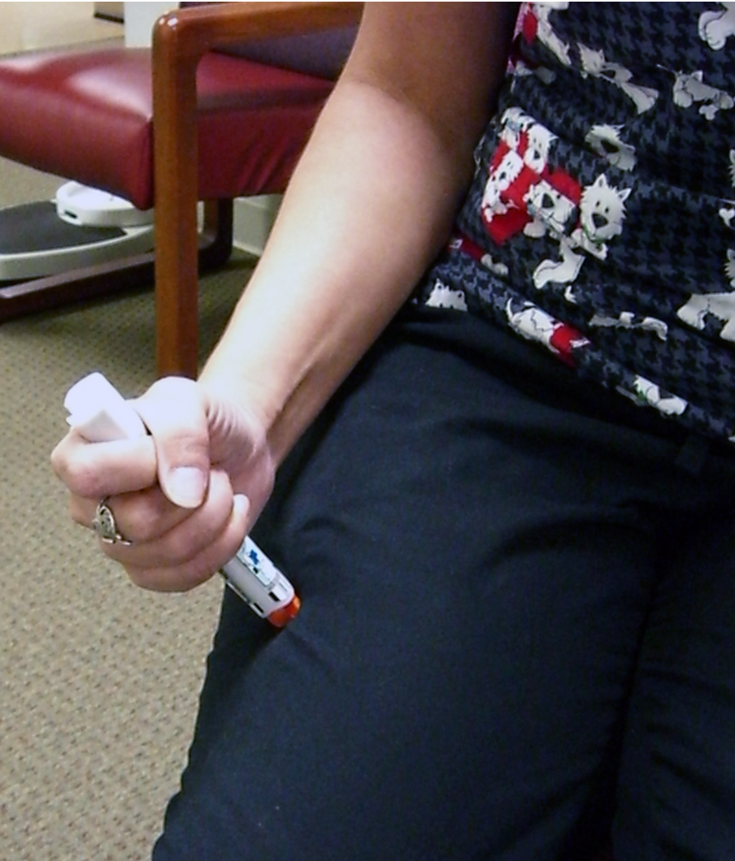
In the event of a someone going into anaphylactic shock
First responders:
Primary treatment would is an adrenaline injection from the First Aid kit
Does the patient have their own syringe
If so encourage them to use it
Where necessary give them the injection in the thigh yourself - ASAP
Make them comfortable
Call an ambulance

Slide 17
Food Allergy quiz?
Notes:
https://www.aaaai.org/conditions-and-treatments/allergies/food-allergies/food-allergy-quiz
https://www.allergyhome.org/food-allergy-quiz-answers-and-explanations/

Slide 18
Food Allergy Quiz 1
Outside of the hospital setting, food allergy is the most common trigger of anaphylaxis in both children and adults.

Slide 19
Food Allergy Quiz 1
True
Food allergens are the most common cause of anaphylaxis
Accounting for about 30 to 40% of cases in all ages
70 to 80% of cases in children.
Notes:
True: Food allergens are the most common cause of anaphylaxis, accounting for about 30 to 40% of cases in all ages and 70 to 80% of cases in children. The exact prevalence of food-induced anaphylaxis in the United States is unknown. Estimates suggest emergency department visits for food-induced acute reactions occur about every 3 minutes and visits for food-induced anaphylaxis every 6 minutes in the United States, and the rates appear to be increasing.

Slide 20
Food Allergy Quiz 2
Infants are at higher risk for fatal food-induced anaphylaxis than teenagers

Slide 21
Food Allergy Quiz 2
False
Case studies suggest that teenagers
Especially with a prior history of asthma,
and the delay in the administration of epinephrine are all associated food-induced anaphylaxis
Notes:
False: Case studies suggest that adolescent/young adult age, a prior history of reaction, absence of symptoms involving or affecting the skin, a history of asthma, and the delay in the administration of epinephrine are all associated with fatal food-induced anaphylaxis.

Slide 22
Food Allergy Quiz 3
The results of food-specific IgE tests (skin prick test, serum levels) reliably predict the severity of future reactions to the food

Slide 23
Food Allergy Quiz 3
False
No current diagnostic test can predict the severity of future reactions.
Notes:
False: Newer diagnostic methods that detect serum IgE to specific components of food allergens may enhance current testing and identify those patients at risk for anaphylaxis, but there is no current diagnostic test can predict the severity of future reactions.

Slide 24
Food Allergy Quiz 4
Exercising after ingesting food may increase the severity of a reaction.

Slide 25
Food Allergy Quiz 4
True
Exercising, having a related viral illness, ingesting alcohol, or taking drugs such as antacids and aspirin may increase the severity of an acute reaction to food.
Notes:
True: Exercising, having a related viral illness, ingesting alcohol, or taking drugs such as antacids, aspirin and NSAIDs may increase the severity of an acute reaction to food.

Slide 26
Food Allergy Quiz 5
A child with peanut allergy has about a 20% chance of outgrowing peanut allergy

Slide 27
Food Allergy Quiz 5
True
In about 20% of children with peanut allergy, it resolves with time.
In children allergic to tree nuts the resolution rate is about 9%.
In contrast, the majority of children with cow milk, egg, soybean, and wheat allergy outgrow these allergies with age.
Notes:
True: In about 20% of children with peanut allergy, it resolves with time. In children allergic to tree nuts the resolution rate is about 9%. In contrast, the majority of children with cow milk, egg, soybean, and wheat allergy outgrow these allergies with age. Those with peak lifetime food-specific serum IgE level greater than 50 kU/L are more likely to retain their allergy until teenage years.

Slide 28
Food Allergy Quiz 6
Peanuts and tree nuts are the most common triggers in cases of fatal food-induced anaphylaxis

Slide 29
Food Allergy Quiz 6
True
Any food can cause food-induced anaphylaxis,
BUT
Peanuts, tree nuts, fish, seeds, shellfish, milk, and egg are the most common trigger foods
Peanut and tree nuts have been identified as triggers in over 90% of cases of fatal food-induced anaphylaxis
Notes:
True: Any food can cause food-induced anaphylaxis, but peanuts, tree nuts, fish, seeds, shellfish, milk, and egg are the most common trigger foods in the United States. In fact, peanut and tree nuts have been identified as triggers in over 90% of cases of fatal food-induced anaphylaxis.

Slide 30
Food Allergy Quiz 7
If someone eats a food you are allergic to and then kisses you on the cheek, you will have a serious (i.e. anaphylactic) reaction

Slide 31
Food Allergy Quiz 7
FALSE
This is a tricky question. You should not get a serious reaction if kissed on the cheek, although you may get hives around the area of the kiss.
Skin acts as a great barrier. Washing your cheek and hands will remove the food.
Notes:
The correct answer is False.
This is a tricky question. You should not get a serious reaction if kissed on the cheek, although you may get hives around the area of the kiss. Skin acts as a great barrier. Washing your cheek and hands will remove the food.
However, there have been instances when people have severe allergic reactions after getting other people’s saliva in their mouth (open mouth kissing, sharing utensils, cups, and water bottles). Letting our significant others know about our allergies, not sharing utensils and beverages, and washing hands before eating will help decrease accidentally eating foods that you are allergic to.

Slide 32
Food Allergy Quiz 8
The smell of peanut butter will cause an allergic reaction in people with peanut allergies

Slide 33
Food Allergy Quiz 8
FALSE
The smell of peanut butter is caused by pyrizines, which are not proteins.
It is the proteins that trigger allergic reactions.
So the smell of peanut butter sandwich from the next table should not cause an allergic reaction.
Notes:
The correct answer is False
The smell of peanut butter is caused by pyrizines, which are not proteins. It is the proteins that trigger allergic reactions. So the smell of peanut butter sandwich from the next table should not cause an allergic reaction.
BUT
people can have reactions when they inhale food proteins that they are allergic to. This can be seen when food is actively cooked, when powdered or crushed forms become aerosolized, or in other situations when proteins are released into the air.

Slide 34
Food Allergy Quiz 9
You can have an allergic reaction if you share your friend’s water bottle.

Slide 35
Food Allergy Quiz 9
TRUE
If you share the bottle of water with someone who recently ate a food that you are allergic to, cross contact with that food can cause a reaction.
Not sharing utensils, glasses or water bottles is safest.
Notes:
The correct answer is True.
If you share the bottle of water with someone who recently ate a food that you are allergic to, cross contact with that food can cause a reaction.
Not sharing utensils, glasses or water bottles is safest.

Slide 36
Food Allergy Quiz 10
Using hand sanitizing gels is a good way to clean your hands of food allergens

Slide 37
Food Allergy Quiz 10
FALSE
Hand gels decrease the amount of protein, but DO NOT remove the protein.
Soap and water and wet wipes do the trick.
Hand gels are helpful for preventing the flu and other infections.
Notes:
False. Hand gels decrease the amount of protein, but DO NOT remove the protein.
Soap and water and wet wipes do the trick. Hand gels are helpful for preventing the flu and other infections.
What Works: Soap and water, commercial Hand wipes
What Doesn’t: Hand sanitizers

Slide 38
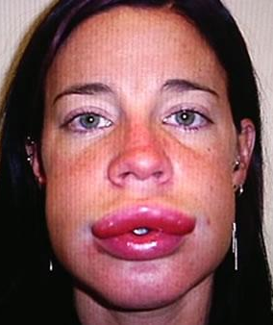
Symptoms of Allergies
Can include:
Itchy sensation inside the mouth, throat or ears
Raised itchy red rash (hives)
Swelling of the face, around the eyes, lips, tongue, roof of mouth
Vomiting

Slide 39
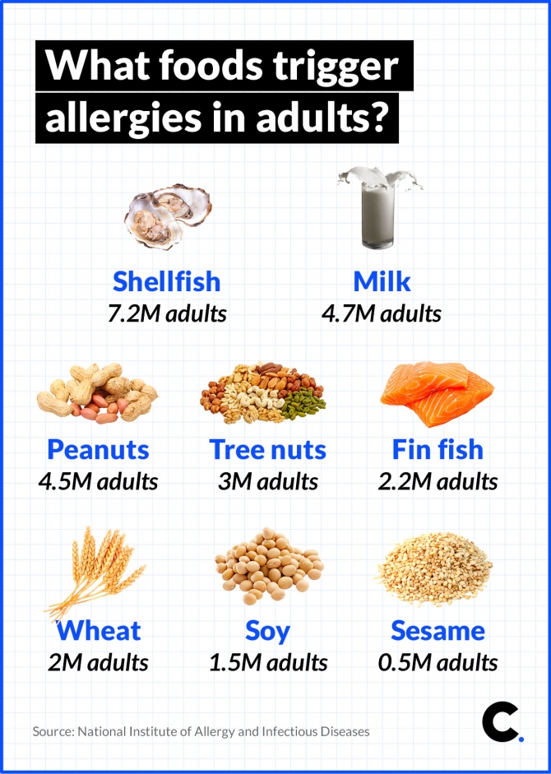
Allergies in Later Life
They are possible
Hayfever
Pets
Commonly developed food allergies in adults are:
Peanuts (ground nuts)
Fish
Shellfish (shrimp or lobster)
Tree Nuts (almonds, walnuts, pecans etc.)
Notes:
https://www.mayoclinic.org/diseases-conditions/food-allergy/expert-answers/food-allergy/faq-20058483
The Journal of the American Medical Association reports that 10.8% of US Adults surveyed had at least one allergy. If this was translated to the American adult population it would mean 26 million adults a have a food allergy.

Slide 40
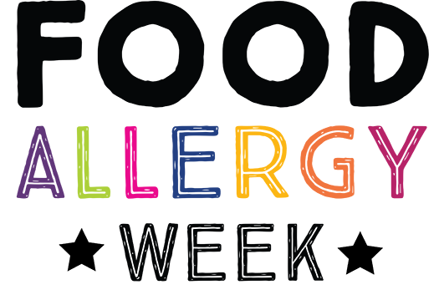
The rise in food allergy cases
The number of people with food allergies has risen sharply over the past few decades
The risen for this is unclear
Although a number of theories
Other allergic conditions such as atopic dermatitis have also increased

Slide 41
What do I cause?
Allergy or Intolerance

Slide 42
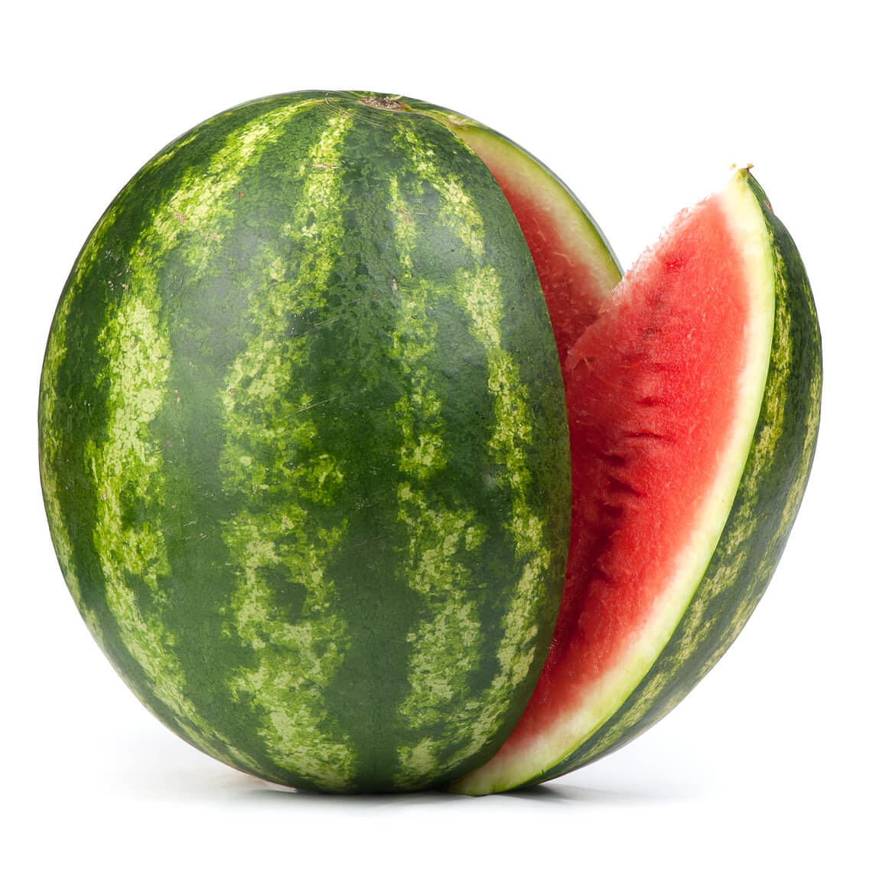
Watermelon

Slide 43
Watermelon
Fructose Intolerance
Also known as:
Fructose Malabsorption
Notes:
Ingredients:
Watermelon

Slide 44

Soy Sauce
Notes:
Soy Sauce
Surprisingly enough there are more than just soybeans in your favorite Asian condiments. Soy sauce is commonly made with fermented wheat. Sorry gluten-free friends, this complementary rice topping is just not on your list of safe foods. Try gluten-free tamari instead because it’s naturally gluten-free. Side note: common sauces and marinades at restaurants include soy sauce in them, so make sure you’re asking.

Slide 45
Soy Sauce
Soy Allergy
Plus:
Gluten intolerance
Notes:
Information
Ingredients
Water, Soybeans, Wheat, Salt
Allergy Information
Contains: Soya, Wheat

Slide 46

Christmas Cake

Slide 47
Christmas Cake
Gluten Intolerance
Egg Allergy
Milk Allergy
Lactose Intolerance
Tree Nut Allergy
Soya Allergy
Sulphyte Allergy (Dried Fruit)
Notes:
INGREDIENTS LIST:
Sultanas (27%), Sugar, Marzipan (11%), Wheat Flour (Wheat Flour, Calcium Carbonate, Iron, Niacin, Thiamin), Raisins (6%), Glucose Syrup, Pasteurised Egg, Butter (Milk), Cherries (4.5%), Humectant (Glycerol), Glucose-Fructose Syrup, Palm Oil, Orange Peel, Barley Malt Extract, Rapeseed Oil, Lemon Peel, Palm Stearin, Preservative (Potassium Sorbate), Colours (Anthocyanins, Beetroot Red, Mixed Carotenes, Riboflavin, Curcumin, Iron Oxide, Titanium Dioxide), Emulsifiers (Mono- and Di-Glycerides of Fatty Acids, Acacia), Acidity Regulator (Citric Acid), Invert Sugar Syrup, Stabiliser (Xanthan Gum), Rice Flour, Orange Oil, Thickeners (Glycerol, Tragacanth), Glazing Agent (Shellac).
Marzipan contains: Sugar, Almonds, Water, Glucose Syrup, Invert Sugar Syrup, Preservative (Potassium Sorbate).
Allergy Information
Contains almond. Also, may contain peanuts, other nuts and soya. For allergens, including cereals containing gluten, see ingredients in bold.

Slide 48
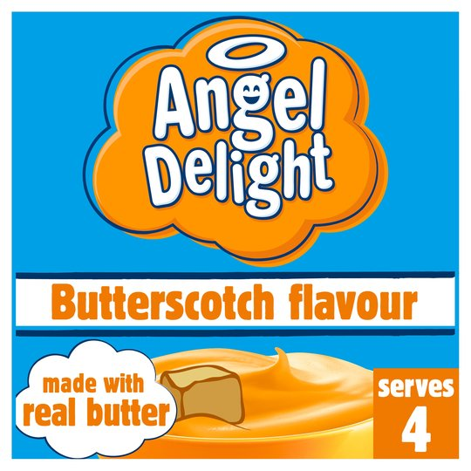
Angel Delight

Slide 49
Angel Delight
Lactose Intolerance
Milk Allergy
Notes:
Ingredients
Sugar, Modified Starch, Palm Oil, Gelling Agents (Sodium Phosphates, Diphosphates), Emulsifiers (Propylene Glycol Esters of Fatty Acids, Lecithins), Lactose (Milk), Colours (Plain Caramel, Carotenes), Milk Proteins, Butter Powder (1%) (Dried Butter (Milk), Glucose Syrup, Milk Proteins, Stabiliser (Triphosphate)), Light Brown Sugar (1%), Whey Powder (Milk), Calcium Carbonate, Anti-Caking Agent (Silicon Dioxide), Flavouring
Allergy Information
May also contain Soya and Wheat

Slide 50
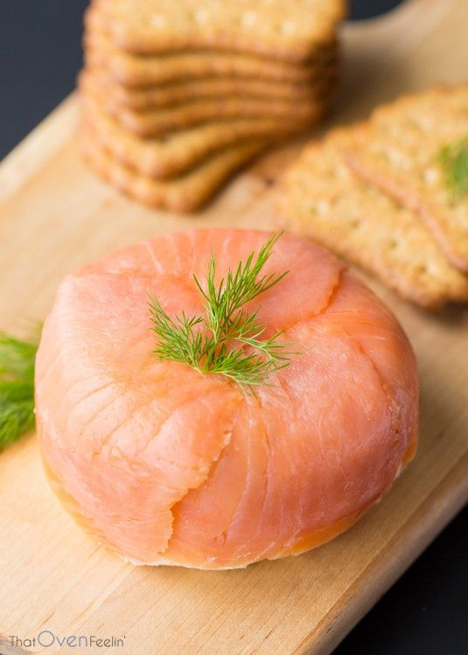
Smoked Salmon Pate

Slide 51
Smoked Salmon Pate
Fish Allergy
Dairy Allergy
Lactose Intolerance
Notes:
Ingredients
Smoked Salmon (25%), Single Cream (Milk), Poached Salmon (15%), Water, Full Fat Soft Cheese (Milk), Rapeseed Oil, Crème Fraîche (Milk), Lemon Juice, Olive Oil, Tapioca Starch, Pasteurised Egg, Tomato Paste, Spirit Vinegar, Salt, Horseradish, Cornflour, Black Pepper.
Smoked Salmon contains: Salmon (Fish), Water, Salt, Brown Sugar.
Poached Salmon contains: Salmon (Fish), Salt, Brown Sugar.
Allergy Information
For allergens, see ingredients in bold

Slide 52

Courgette
Notes:
Ingredients
Courgette

Slide 53
Courgette
Salicylate Intolerance
Notes:
Ingredients
Courgette

Slide 54
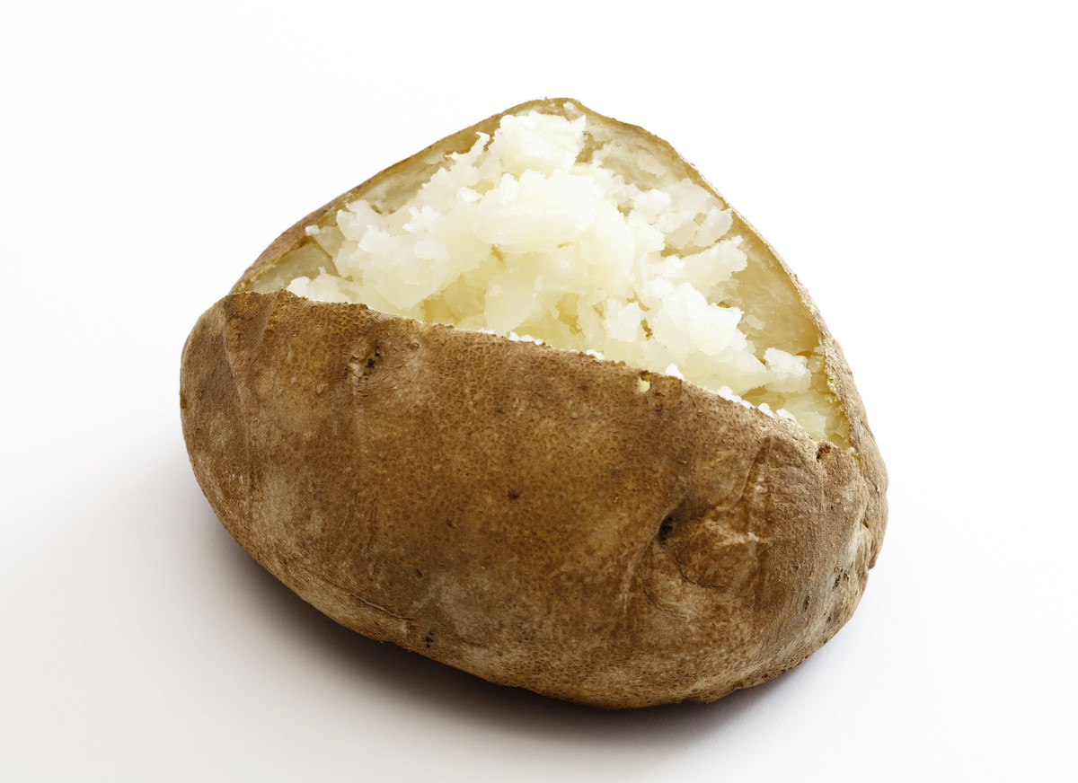
Baked Potato

Slide 55
Baked Potato
Nightshade Intolerance
Notes:
Ingredients:
Potato

Slide 56
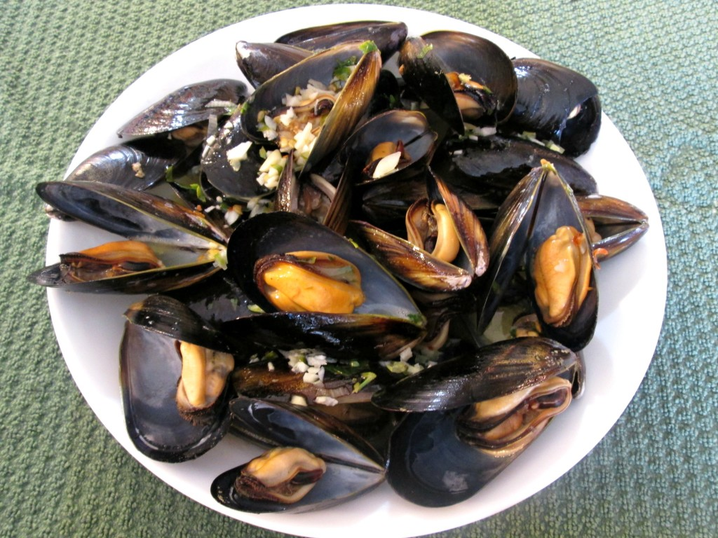
Moules Marinieres

Slide 57
Moules Marinieres
Mollusc Allergy
Dairy Allergy
Lactose Intolerance
Notes:
Ingredients
Mussels (Molluscs) (88%), Butter (Milk) (4%), Water, Garlic Purée (2%), Shallots, Cornflour, Parsley, Black Pepper, Lemon Juice
Allergen Information
Contains Milk, Contains Molluscs

Slide 58

Reese’s Pieces
Notes:
Ingredients
Milk Chocolate Flavoured Coating (71%) [Sugar*; Cocoa Butter; Cocoa Mass; Skimmed Milk Powder; Milk Fat; Lactose (Milk); Emulsifiers: Soya Lecithin*, E476], Peanut Butter Creme Centre (29%) [Peanuts; Sugar*; Dextrose*; Cocoa Butter; Partially Hydrogenated Vegetable Oil (Palm Kernel and Palm Oil); Salt; Palm Kernel Oil; Cornstarch*; Antioxidant: E319, Citric Acid], *Produced from genetically modified Sugar Beet, Corn and Soya Beans
Allergy Information
May contain traces of Almonds

Slide 59
Reese’s Pieces
Peanut Allergy
Milk Allergy
Lactose Intolerance
Soya Allergy
Notes:
Ingredients
Milk Chocolate Flavoured Coating (71%) [Sugar*; Cocoa Butter; Cocoa Mass; Skimmed Milk Powder; Milk Fat; Lactose (Milk); Emulsifiers: Soya Lecithin*, E476], Peanut Butter Creme Centre (29%) [Peanuts; Sugar*; Dextrose*; Cocoa Butter; Partially Hydrogenated Vegetable Oil (Palm Kernel and Palm Oil); Salt; Palm Kernel Oil; Cornstarch*; Antioxidant: E319, Citric Acid], *Produced from genetically modified Sugar Beet, Corn and Soya Beans
Allergy Information
May contain traces of Almonds

Slide 60
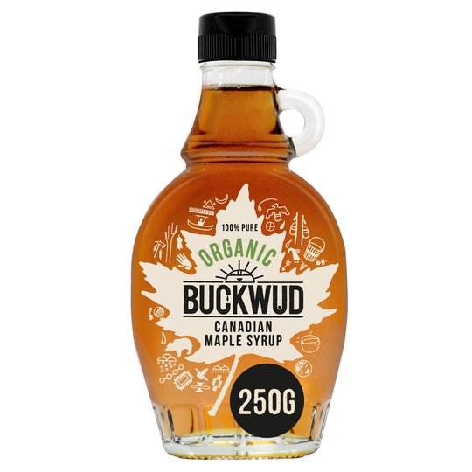
Maple Syrup

Slide 61
Maple Syrup
Histamine intolerance
Notes:
Ingredients
Maple Syrup

Slide 62
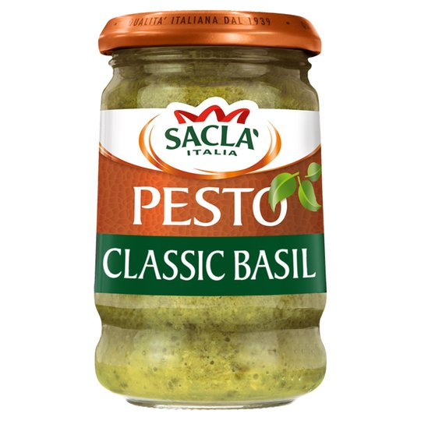
Pesto Sauce
Notes:
Ingredients
Sunflower Seed Oil, Italian Basil (36%), Cashew Nuts, Grana Padano PDO Cheese (Milk, Egg), Sea Salt, Glucose, Pecorino Romano PDO Cheese (Milk), Crushed Pine Kernels, Extra Virgin Olive Oil, Flavourings, Potato Flakes, Acidity Regulator: Lactic Acid
Allergy Information
May also contain other Nuts

Slide 63
Pesto Sauce
Tree Nuts
Milk allergy
Lactose Intolerance
Egg Allergy
Notes:
Ingredients
Sunflower Seed Oil, Italian Basil (36%), Cashew Nuts, Grana Padano PDO Cheese (Milk, Egg), Sea Salt, Glucose, Pecorino Romano PDO Cheese (Milk), Crushed Pine Kernels, Extra Virgin Olive Oil, Flavourings, Potato Flakes, Acidity Regulator: Lactic Acid
Allergy Information
May also contain other Nuts

Slide 64

Salted Caramel Mocha Frappuccino
Notes:
Ingredients
Ice, Milk, Coffee Frappuccino Syrup [Sugar, Water, Salt, Natural And Artificial Flavors, Xanthan Gum, Potassium Sorbate, Citric Acid], Whipped Cream [Cream (Cream, Mono And Diglycerides, Carageenan), Vanilla Syrup (Sugar, Water, Natural Flavors, Potassium Sorbate, Citric Acid)], Coffee, Mocha Sauce [Water, Sugar, Cocoa Processed With Alkali, Natural Flavor], Toffee Nut Syrup [Sugar, Water, Natural Flavor, Salt, Sodium Benzoate, Citric Acid], Caramel Sauce [Sugar, Corn Syrup, Butter (Cream [Milk], Salt), Water, Heavy Cream, Nonfat Dry Milk, Natural Flavors, Salt, Mono & Diglycerides, Soy Lecithin, Sulfites], Sea Salt Topping [Turbinado Sugar, Smoked Sea Salt, Less Than 2% Silicon Dioxide].
We cannot guarantee that any unpackaged products served in our stores are allergen-free because we use shared equipment to store, prepare, and serve them. Customers with allergies can find ingredient information for products on the labels of our packaged products or online at Starbucks.com/menu.

Slide 65
Salted Caramel Mocha Frappuccino
Dairy Allergy
Lactose Intolerance
Fructose Intolerance
Sulphite Allergy
Notes:
Ingredients
Ice, Milk, Coffee Frappuccino Syrup [Sugar, Water, Salt, Natural And Artificial Flavors, Xanthan Gum, Potassium Sorbate, Citric Acid], Whipped Cream [Cream (Cream, Mono And Diglycerides, Carageenan), Vanilla Syrup (Sugar, Water, Natural Flavors, Potassium Sorbate, Citric Acid)], Coffee, Mocha Sauce [Water, Sugar, Cocoa Processed With Alkali, Natural Flavor], Toffee Nut Syrup [Sugar, Water, Natural Flavor, Salt, Sodium Benzoate, Citric Acid], Caramel Sauce [Sugar, Corn Syrup, Butter (Cream [Milk], Salt), Water, Heavy Cream, Nonfat Dry Milk, Natural Flavors, Salt, Mono & Diglycerides, Soy Lecithin, Sulfites], Sea Salt Topping [Turbinado Sugar, Smoked Sea Salt, Less Than 2% Silicon Dioxide].
We cannot guarantee that any unpackaged products served in our stores are allergen-free because we use shared equipment to store, prepare, and serve them. Customers with allergies can find ingredient information for products on the labels of our packaged products or online at Starbucks.com/menu.

Slide 66
What is food intolerance?

Slide 67
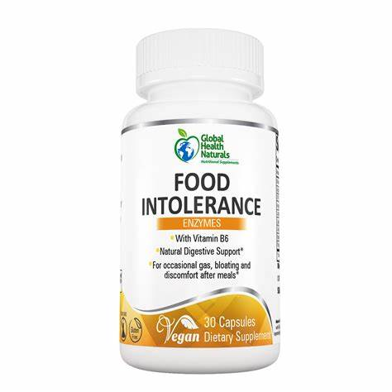
What's the difference between a food intolerance and a food allergy?
A reaction to a food that does not involve the immune system
Examples include:
  Lactose intolerance
  Irritable Bowel Syndrome
A food intolerance can cause some of the same signs and symptoms
An intolerance will make you uncomfortable
An allergy will kill you

Slide 68

Dairy Free
Sensitivity to Cow’s milk
The ability to digest Cow’s milk is a very recent evolutionary change for N. Europeans
In the UK it mainly affects people of Asian and African descent
About 2% of people of North European ancestry affected
90% of people from China affected
Notes:
How have humans tolerance evolved?
Humans are able to digest milk past childhood only because of a genetic adaptation. Research suggests the gene for breaking down lactose in milk was non-existent 20,000 years ago and was still very rare during the Bronze Age – a minuscule amount of time in evolutionary terms.
Brian Handwerk for Smithsonian.com says: “That lightning-fast evolutionary change suggests that direct milk consumption must have provided a serious survival advantage over peoples who had to ferment dairy into yogurt or cheese”.
While still affecting a majority of the world’s population, these days, many humans have access to plentiful alternative foods as well as lactose-free milk or lactase pills that help them digest regular dairy.
“In other words,” says Handwerk, “we can circumvent some impacts of natural selection. That means traits like lactose tolerance might not have the same direct impacts on survival or reproduction that they once did—at least in some parts of the world”

Slide 69
What are the alternatives for Dairy & Lactose in cooking?

Slide 70

Tips for Dairy Free Cooking
1 Cup of Cow’s Milk can be replaced with:
1 Cup of Soy milk
1 Cup of Rice milk + 1 tbsp of oil, or a milk free spread
1 Cup of fruit puree (for baked goods such as muffins
1 Cup of water or stock for savoury recipes

Slide 71
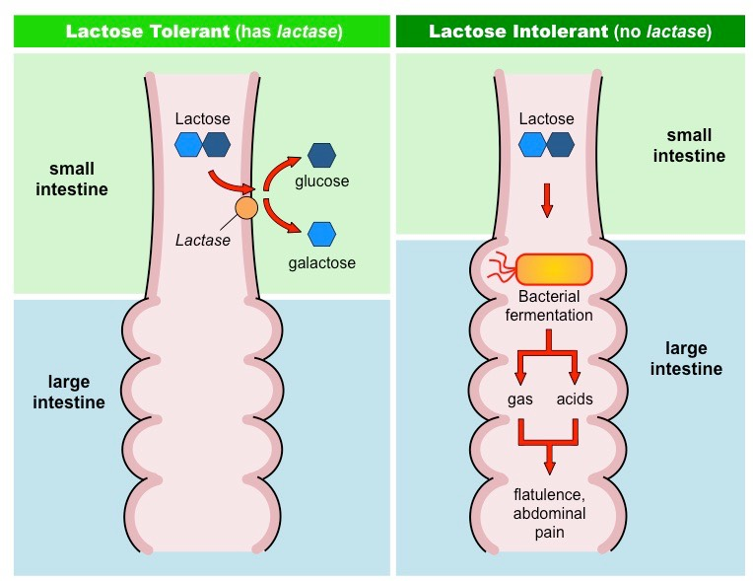
Lactose Free
Lactose is the sugar found in milk
Your body produces Lactase to digest it
If your body doesn’t produce enough Lactase to digest Lactose you develop
  Lactose Intolerance
Notes:
What is lactose and why are some people intolerant to it?
Lactose is the main sugar found in milk and other dairy products. Those who have lactose intolerance find it hard to digest the sugar, usually because their small intestine doesn't make enough lactase, the enzyme which digests lactose.
Who is affected?
Around 60% of adult humans are lactose intolerant or have reduced lactose tolerance after infancy. But tolerance varies dramatically depending on geography, affecting some ethnic groups more than others.
In Britain, the condition is most prevalent among the Asian and African-Caribbean communities, according to the NHS. Only one person in 50 of northern European descent has some degree of lactose intolerance, while around 90% of people from China have the condition.
Scientists believe this because places in Africa and Asia historically had little access to milk, so people may not have evolved the ability to digest lactose because there was no benefit in being able to do so.

Slide 72
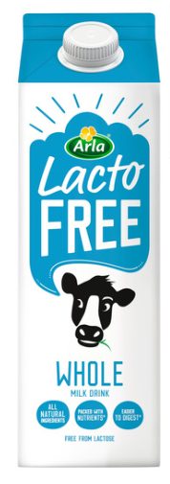

Tips for Lactose-Free Cooking
Substitute any milk, custard, cream, soft cheeses, ice cream with:
Low Lactose Milk
Dairy free alternative

Slide 73
Is Lactose Intolerance the same as a Dairy Allergy?
NO
"Intolerances are different to food allergies; they are not caused by the immune system and are not life threatening,“
Amena Warner, the head of clinical services at AllergyUK

Slide 74

Coeliac Disease
Also known as Gluten Intolerance
Genetic Disorder
Affects about 1% of the population
React to gluten protein in:
  Wheat
  Barley
  Rye
  Oats
Notes:
Also Malt, Spelt and Triticale

Slide 75

Unsafe Foods
Gluten is found in:
  Breads
  Biscuits
  Cakes
  Pizza
  Pastry
  Pasta
  Breadcrumbs
  Food Additives in the 1400 to 1450 range
Notes:
Unsafe foods
If you require a gluten-free diet, avoid any products which contain the following ingredients: wheat, rye, barley, triticale, oats, flour (unless a gluten-free source is specified); pasta, semolina; farina or thickeners; wheat starch, starch (if not specified as gluten-free); cereal, bread, biscuit, batter, crumbs; corn flour (if not specified as gluten-free); malt.
There may be small traces of gluten in the following food additives: modified starch or thickening agent; additive numbers 1400-1450; malt flavouring and malt extract; maltodextrin (of wheat origin); hydrolysed protein (of wheat origin).

Slide 76
What is an alternative Gluten in cooking

Slide 77
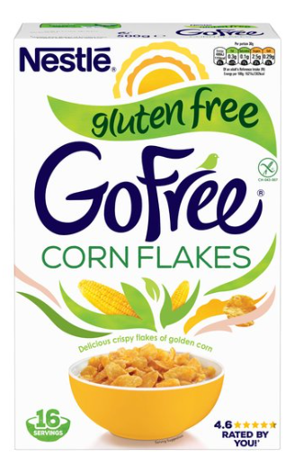
Safe Foods: Grains and Flours
Arrowroot
Non-Malted Rice
Maize (Corn)
Buckwheat Flour
Sorghum
Quinoa
Rice (white & brown)
Sago Tapioca
Pea, Gram, Lupin, Potato, Lentil and Soya Flours
Notes:
The cornflakes are also certified Kosher

Slide 78
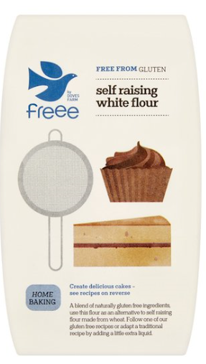
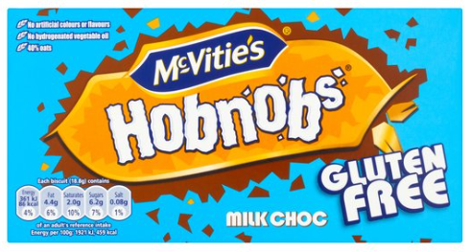
Tips for Gluten Free cooking
Gluten free flours produce baked goods that are:
  Flatter
  Heavier
  Crumblier
Gluten gives elasticity and helps hold air
Try ‘all-purpose’ gluten free flours available in supermarkets
Experiment
Combine flours e.g. potato or Rice + Soy flour

Slide 79
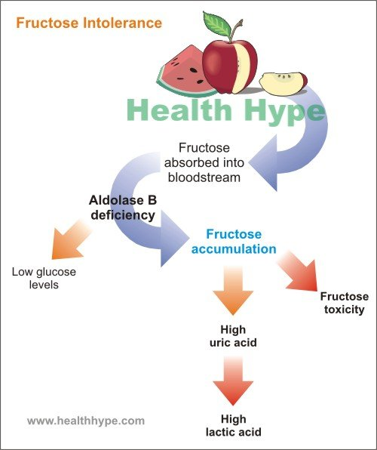
Fructose Malabsorption
AKA Fructose Intolerance
Often mistaken for IBS
Might be caused by other conditions such as Coeliac disease
Not the same as Hereditary Fructose Intolerance
Notes:
IBS = Irritable Bowel Syndrome

Slide 80
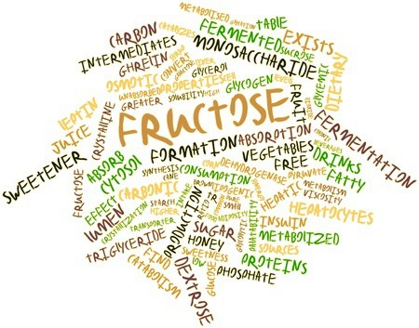
Unsafe Foods
Anything with more than 0.5g of fructose in 100g should be avoided
  Sodas (e.g. Coca Cola)
  Honey
  Corn Syrup
Foods high in fructans and FODMAPs
  Artichokes
  Asparagus
  Leeks
  Onions
  Wheat
Notes:
fermentable oligo-, di- and mono-saccharides and polyols = FODMAPs

Slide 81
What is an alternative to Fructose in cooking

Slide 82
Tips for Fructose Free cooking
Most fruits are considered as high in fructose
There are a few that get the green signal.
Fructose free fruits:
  Blackberries
  Blueberries
  Lemons
  Limes
  Raspberries
  Rhubarb
  Strawberries
There are some vegetables that are very low in fructose content
They can be considered safe for consumption
These vegetables are:
  Cabbage and Cauliflower
  Celery and Cucumbers
  Chickpeas
  Green peppers
  Black, Haricot & Kidney Beans
  Leafy greens
  Lentils
  Mushrooms
  Shallots

Slide 83
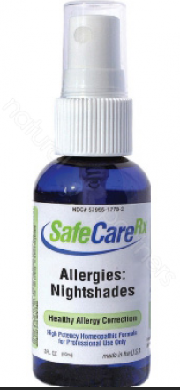
Nightshades
People with a nightshade allergy can develop:
  Breathing problems
  Rash
  Eczema
After eating certain vegetables
Nightshade sensitivity means food are not digested properly
Causing digestive issues

Slide 84
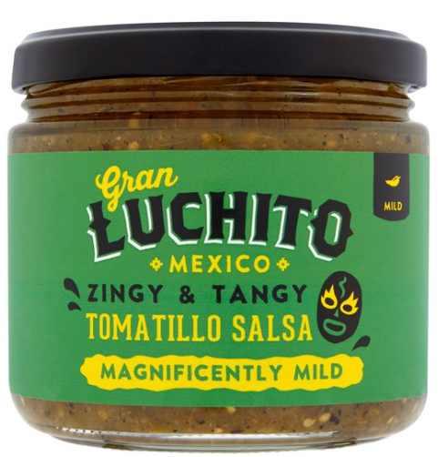
What are Nightshades?
Botanical Family:
  Solanaceae
Over 2,000 plants in that family
Most inedible and poisonous
Some are super yummy:
  White Potatoes
  Aubergine
  Peppers
  Tomatoes
  Cayenne Pepper
  Tomatillo (?)

Slide 85
What is an alternative to NIGHTSHADES in cooking

Slide 86
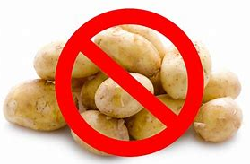
Tips for cooking with Nightshades
Substitution seems to be the way forward
Out Go:
  Potatoes
In Come:
  Sweet Potato
  Cauliflower
  Parsnips
  Carrots
Out Go:
  Tomatoes
In Come (depending of the recipe)
  Apples
  Grapefruit
  Beets
  Butternut Squash
Out Go:
  Aubergine
In Come:
  Portobello Mushrooms
  Shititake Mushrooms

Slide 87

Salicylate Sensitivity
What are Salicylates?
Salts of salicylic acid
Used by plants to defend themselves against insect damage
A daily intake will normally be 10 to 200mg
Aspirin is a derivative of Salicylic Acid
An ordinary dose of aspirin would be 325mg
Found in:
  Fruits
  Vegetable
  Spices
Not usually found in:
  Meat
  Fish
  Dairy
  Cereals
Notes:
IBS = Irritable Bowel Syndrome
Aspirin is a derivative of Salicylic Acid
https://www.dietvsdisease.org/salicylate-intolerance/

Slide 88
What are alternatives to Salicylates in cooking

Slide 89
Tips for Salicylate cooking
The level of Salicylate in foods vary
Very High levels are found in:
Berries and Grapes
Spices
Sweet Peppers
Almond and Peanuts
Tea
Wine, Port, Champagne
Licorice
Mint
Chewing Gum
  Negligible Levels:
  Pears and Bananas
  Cabbage and Leeks
  Peeled Potatoes
  Soybeans
  Cashews
  All grains except Maize
  Garlic and leafy herbs
  De-Caffe Coffee
  Cocoa Powder
  Sugar
  Maple Syrup
Notes:
https://www.dietvsdisease.org/salicylate-intolerance/
Leafy herbs = Parsley, Coriander, Chives

Slide 90
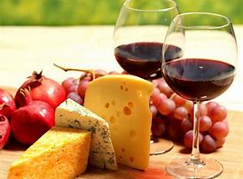
Histamine Intolerance
Also known as histaminosis
Affects 1% of population
80% of those are middle-aged
Histamine containing food (e.g. Wine and Cheese) can lead to a pseudo allergic reaction

Slide 91

A “What Now”?
A Pseudo-allergic Reaction
You have similar symptoms to an Allergic Attack
Not caused by your immune system
Usually caused by an excess of histamine
Histamine is in things like Port and Stilton

Slide 92
What are alternatives to histamines in cooking
Notes:
ttps://www.histamineintolerance.org.uk/about/the-food-diary/the-food-list/

Slide 93
Histamine Intolerance Awareness
Avoid or reduce eating:
Canned Foods
Ready meals
Ripened and fermented foods:
  Older (riper) cheeses
  Alcohol
  Yeast products
Strawberries
Tomatoes
Smoked meats
Shellfish
Low histamine foods:
  Fresh Meat
  Fresh Fish
  Skinless chicken
  Egg yolk
  Fresh Fruits
  Fresh Vegetables
  Fresh Pasteurised Milk
  Milk substitutes
  Cream cheese
Notes:
Basically everything fresh. Nothing Stale or Old and nothing mouldy.

Slide 94
Break
Be back in 15 minutes!

Slide 95
Who is the customer?
University of Oxford

Slide 96
Who are my customers?
Around the diagram, write the types of people you come into contact with, who you regard as your customers
YOU

Slide 97







External and internal customers
Conferences
College Staff
Students
YOU
Admin Staff
Academic Staff
Language Schools
Maintenance Staff

Slide 98
Our customers include:
People who use our services
People acting on behalf of people who use our services
Staff in the University – our internal customers
Contractors working for the University – our external customers
Other stakeholders

Slide 99
What is a customer?
A customer is anyone who comes to you, or relies on you, for a service or for information
Even if you do not provide a service directly to a customer, you will be providing a service to someone who does

Slide 100
On the topic of your customers
How aware are you of how well you treat your colleagues?
Do you provide the same level of professionalism and care to all your customers?
The approaches we use with our colleagues should mirror those we use with other customers

Slide 101
Importance internal customers
Great customer service means delivering a service to everyone we come into contact with, on top of the job we’re actually employed to do
Treating your colleagues with great customer care and respect is as important as it is with other customers
“It's almost impossible to provide good external service if you and your organisation are not providing good internal service."
Benjamin Schneider, University of Maryland

Slide 102
Allergens
Introduction and Explanation
Notes:
Just a quick introduction on what’s to come

Slide 103
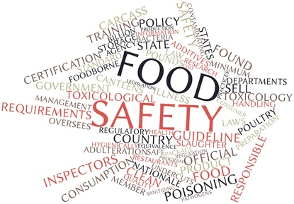

Allergen Guidance
As a food business, you must follow the allergen information rules set in EU Food Information for Consumers (EU FIC). This means you must:
Provide allergen information for both pre-packed and non-prepacked food or drink
Handle and mange food allergens adequately
Train staff about allergens

Slide 104

14 Allergens Covered by EU Law
Celery
Crustaceans
Eggs
Fish
Gluten
Lupin
Milk
Molluscs
Mustard
Peanuts
Sesame
Soya
Sulphites
Tree Nuts

Slide 105
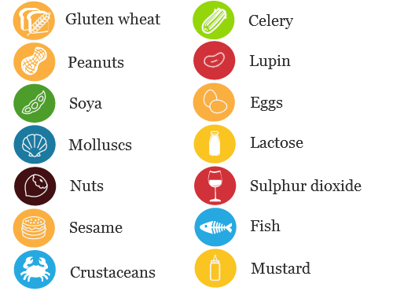
Presentation of ingredients
Allergenic ingredients need to be emphasised:
Clearly distinguished from the rest of the ingredients
Food businesses can choose how to emphasise the 14 allergens
When a product is not required to give an ingredients list
Notes:
The allergenic ingredients need to be emphasised using a typeset that clearly distinguishes it from the rest of the ingredients, for example by means of the font, style or background colour. Food businesses can choose what method they want to use to emphasise the 14 allergens on their product label.
When a product is not required to provide an ingredients list such as a bottle of wine, any allergenic ingredients within this product must be declared using a ‘contains’ statement followed by the name of the allergenic substance as listed in Annex II and Commission Delegated Regulation (EU) No. 78/2014 amending Annex II to Regulation (EU) No 1169/2011
Where several ingredients or processing aids in a food originates from a single allergenic ingredient, the labelling should make this clear for each ingredient or processing aid concerned. For example, skimmed milk powder, whey (milk), lactose (milk)
Where the name of the food (such as a box of eggs or bag of peanuts) clearly refers to the allergenic ingredients concerned, there is no need for a separate declaration of the allergenic food
Where foods are offered to sale to the final consumer or to mass caterers without packaging, or where foods are packed on the sales premises at the consumer’s request or prepacked for direct sale, information about allergenic ingredients is mandatory and must be provided
Allergen information must be provided for non-prepacked foods in written or oral formats with clear signposting to where consumers can obtain this information, when it is not provided upfront

Slide 106
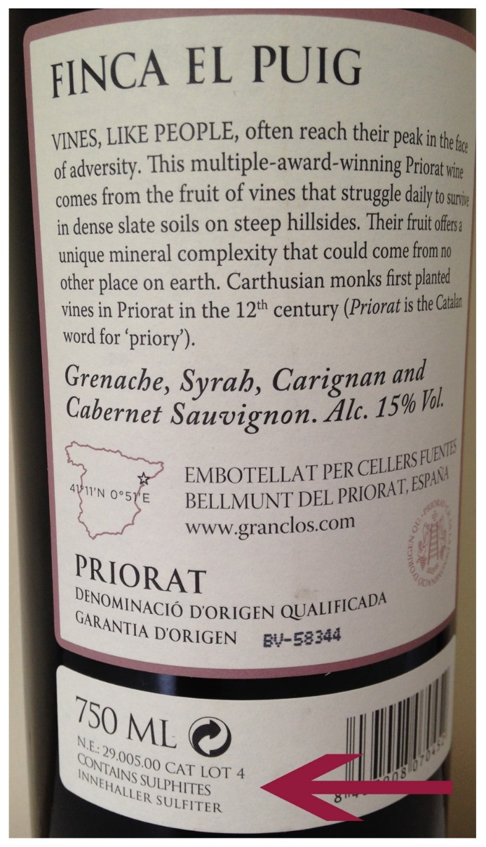
But what about
When a product is not required to give an ingredient list e.g. wine
It must use a “contains” statement
If an allergenic ingredient appears in a different form the labelling has to make it clear:
  Skimmed Milk Powder
  Whey (Milk)
  Lactose (Milk)

Slide 107
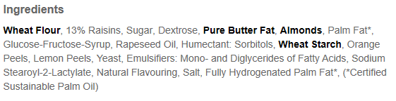
What this looks like on the label
Notes:
This is the label for

Slide 108


What happens when not on the menu
Owen Carey was misled by Byron Burgers menu
He informed staff of his allergy to dairy
Suffered a reaction after eating grilled chicken coated in buttermilk
Collapsed less than an hour later and died from "a severe anaphylactic reaction".
Notes:
Report in the Evening Standard 12th September, 2019

Slide 109
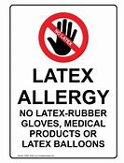

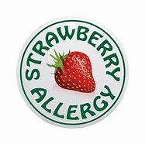
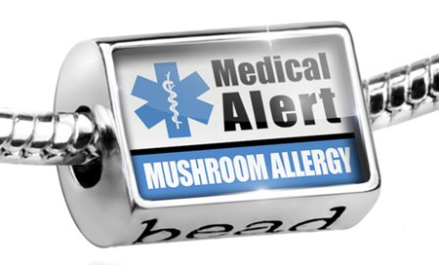
Other Allergens
Allergens covered by the are the top 14.
There are others you may know of including:
Rice
Mushrooms
Strawberries
Cotton
Avocados
Beer
Penicillin
Latex

Slide 110
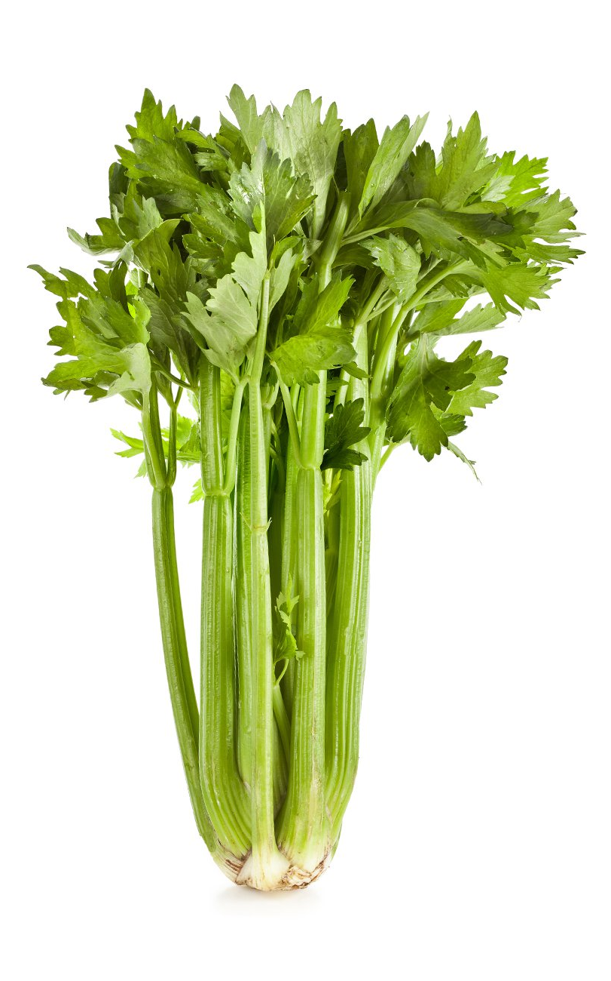
1. Celery
Celery allergy is a common allergy
Celery is widely used in foods, and is served as simple sticks,
Celeriac root, the leaves can be eaten
Celery can be powdered and used as a spice
Celery seeds used to make celery salt.

Slide 111
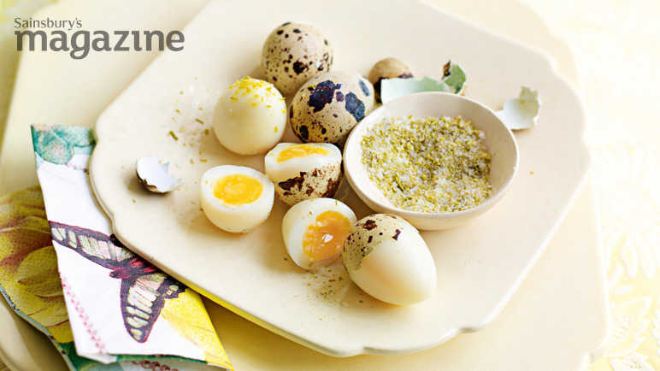
1. What to look for on the label
Celery seed
Celery leaf
Celery salt
Celariac
Celeriac stalk
Celery stalk
Notes:
Quail eggs with Celery Salt

Slide 112
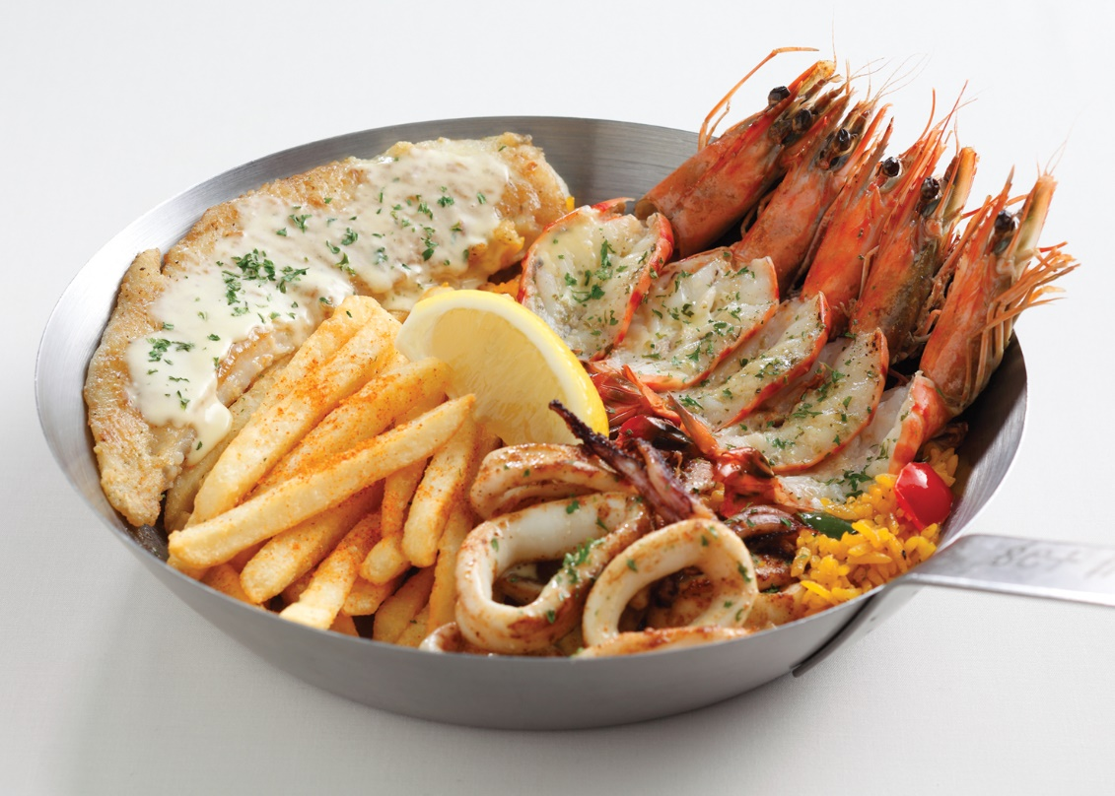
2. Crustaceans
Includes crabs, crayfish, lobster, prawns and shrimps,
Shellfish allergy is quite unusual in children
Develops as teens or young adults
Crustacean allergy is normally lifelong.

Slide 113
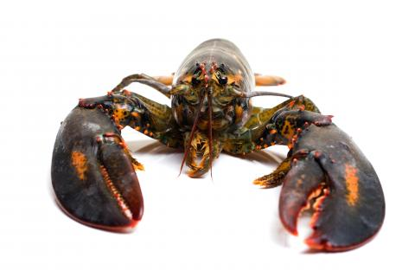
2. What to look for on the label
Amphipods
Barnacles
Crabs
Hermit Crabs
Crayfish
Isopods
Lobsters
Mantis Shrimp
Mussel Shrimp
Mysids
Sea Spiders
Shrimp
Prawns

Slide 114
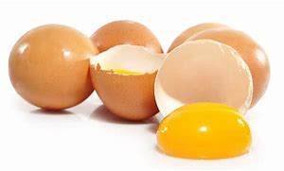
3. Eggs
Egg is a common cause of allergic reactions in both infants and children
For some people will continue into adult life
Most cases of egg allergy are mild
more severe symptoms can lead to anaphylactic shock.

Slide 115

3. What to look for on the Label
Albumin
Apovitellin
Cholesterol free egg substitute
Dried egg solids
Dried egg
Egg
Egg white
Egg yolk
Egg wash
Eggnog
Fat substitutes
Globulin
Livetin
Lysozyme
Mayonnaise
Meringue
Meringue powder
Ovalbumin
Ovoglobulin
Ovomucin
Ovomucoid
Ovotransferrin
Ovovitelia
Ovovitellin
Powdered eggs
Silici albuminate
Simplesse
Surimi
Trailblazer
Vitellin
Whole egg

Slide 116
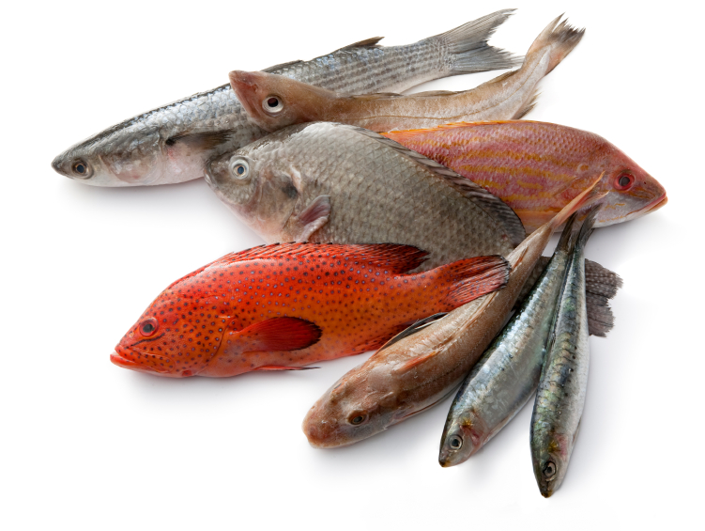
4. Fish
Fish allergy is normally lifelong
Allergic reactions can be serious and symptoms may come on rapidly
People who are allergic to one type of fish may have a good chance of reacting to other types of fish

Slide 117
4. What to look for on the label
Anchovies
Bass
Catfish
Cod
Flounder
Grouper
Haddock
Hake
Halibut
Herring
Mahi Mahi
Perch
Pike
Pollock,
Salmon
Scrod
Swordfish
Sole
Snapper
Tilapia
Trout
Tuna

Slide 118
The menu of forgetfulness Part 1

Slide 119
The Menu of Forgetfulness
The person responsible for labelling the allergens on the menu items has forgotten to do them.
Working in Pairs can you put in the correct allergens for today and tomorrow’s menus
Just put in Celery, Crustaceans, Eggs and Fish for now.

Slide 120
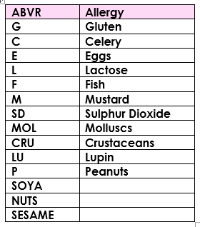
This list Jesus College uses
If colleges have their own codes participants should use the one they are most familiar with.
Notes:
This is the list Jesus College uses. If colleges have their own codes then they should use the one they are most familiar with

Slide 121
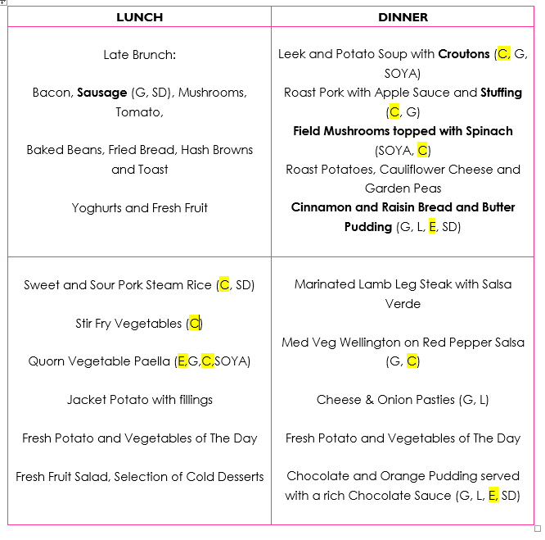
It Should look like this
Notes:
There are no fish or crustaceans in any of these meals
Eggs are a given – what is really surprising is the amount of Celery in the meals.

Slide 122
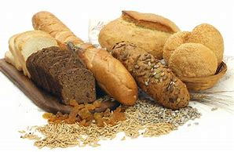
5. Gluten
Gluten is a cereal protein found in wheat, barley and rye
Gluten allergy occurs in children as well as adults but is normally outgrown
The reaction to wheat may not be an allergic one
It could be an intolerance or Coeliac disease

Slide 123
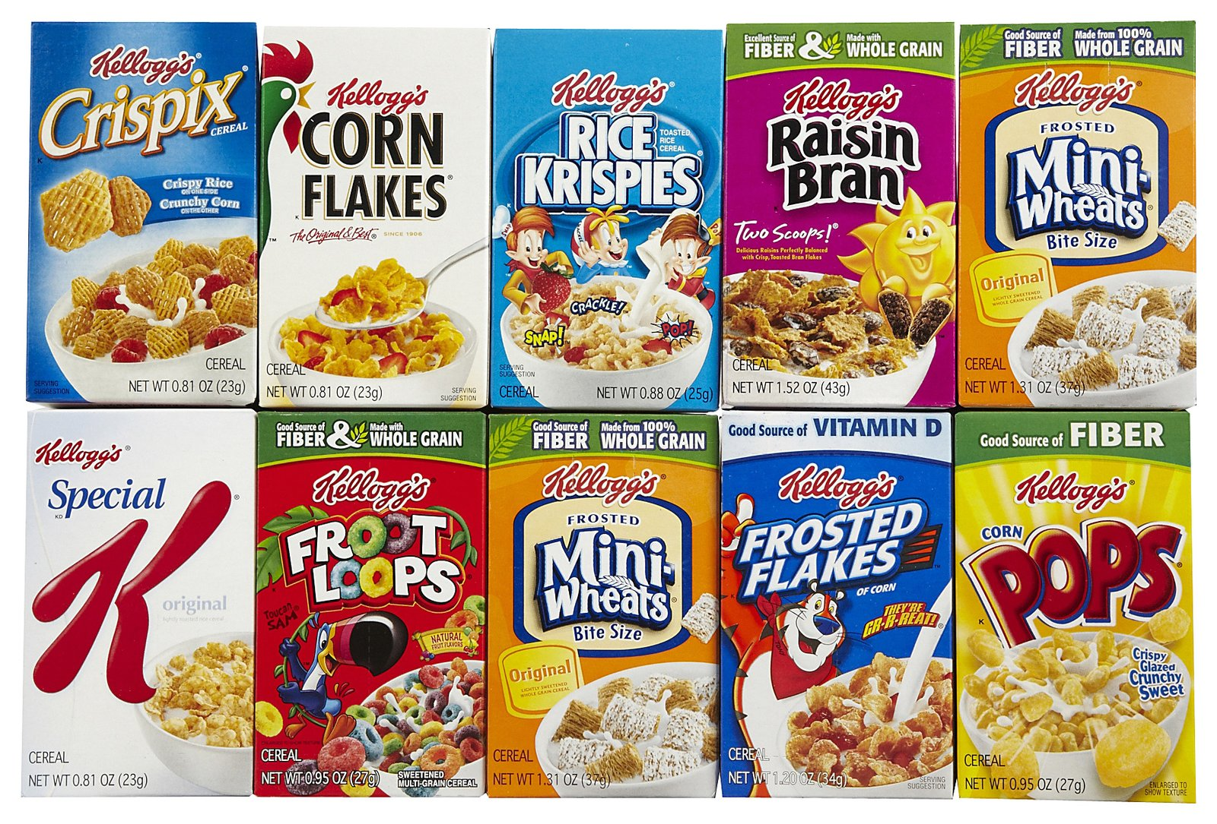
5. What to look for on the label
Wheat
Durum wheat
Semolina
Spelt
Kamut
Einkorn wheat
Faro
Barley
Rye
Oat
Malt
Couscous
Notes:
Khorasan Wheat commercially sold as Kamut
Einkorn = the earliest form of domesticated wheat

Slide 124
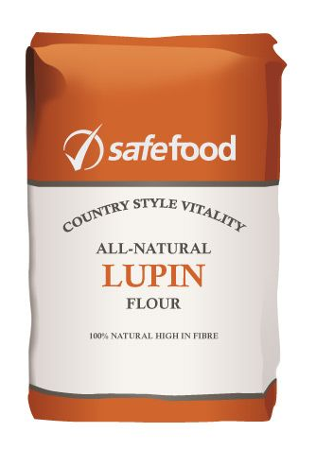
6. Lupin
Lupin is a garden flower
Seeds from some varieties of lupin are cultivated as food
They can be eaten whole
Crushed they make lupin flour and used in:
  Baking
  Pancakes
  Pasta
Some people with Lupin Allergy are also allergic to peanuts.

Slide 125
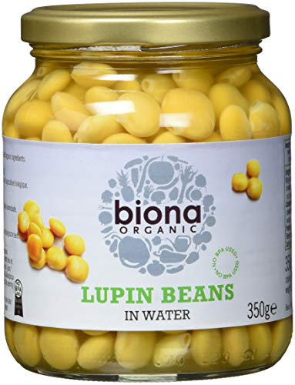
6. What to look for on the label
Lupine
Lupin flour
Lupin seed
Lupin bean

Slide 126
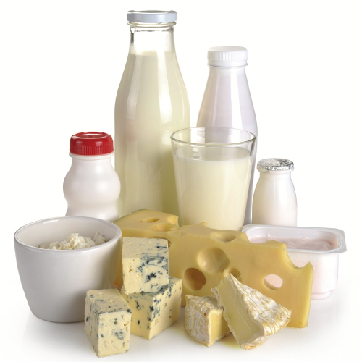
7. Milk
Milk allergy occurs when proteins in milk cause the immune system to mistakenly perceive them to be a threat.
Milk allergy can occur in babies and children and generally ceases,
Occasionally it persists into adulthood

Slide 127
7. What to look for on the label
Milk
Acidophilus milk
Buttermilk
Buttermilk blend
Buttermilk solids
Cultured milk
Condensed milk
Dried milk
Dry milk solids (DMS)
Evaporated milk
Fat‐free milk
Fully cream milk powder
Goat’s milk
Lactose free milk
low fat milk
Malted milk
Milk derivative
Milk powder
Milk protein
Milk solids
Milk solid pastes
Nonfat dry milk
Nonfat milk
Nonfat milk solids
Pasteurised milk,

Slide 128
7. What to look for on the label
Powdered milk
Sheep’s milk
Skim milk
Skim milk powder
Sour milk
Sour milk solids
Sweet cream buttermilk powder
Sweetened condensed milk
Sweetened condensed skim milk
Whole milk
1% milk
2% milk
Butter
Artificial butter
Artificial butter flavour
Butter extract
Butter fat
Butter Flavoured oil
Butter solids
Dairy butter
Natural butter
Natural butter flavour
Whipped butter
Casein & caseinates

Slide 129
7. What to look for on the label
Ammonium caseinate
Calcium caseinate
Hydrolyzed casein
Iron caseinate
Magnesium caseinate
Potassium caseinate
Sodium caseinate
zinc caseinate
Cheese – All Cheeses
Cream
Whipped Cream
Curds
etc
Notes:
Milk — acidophilus milk, buttermilk, buttermilk blend, buttermilk solids, cultured milk, condensed milk, dried milk, dry milk solids (DMS), evaporated milk, fat‐free milk, fully cream milk powder, goat’s milk, lactose free milk, low fat milk, malted milk, milk derivative, milk powder, milk protein, milk solids, milk solid pastes, nonfat dry milk, nonfat milk, nonfat milk solids, pasteurised milk, powdered milk, sheep’s milk, skim milk, skim milk powder, sour milk, sour milk solids, sweet cream buttermilk powder, sweetened condensed milk, sweetened condensed skim milk,whole milk, 1% milk, 2% milk, Butter — artificial butter, artificial butter flavour, butter, butter extract, butter fat, butter flavoured oil, butter solids, dairy butter, natural butter, natural butter flavour, whipped butter, Casein & caseinates — ammonium caseinate, calcium caseinate, hydrolyzed casein, iron caseinate magnesium caseinate, potassium caseinate, sodium caseinate, zinc caseinate,
Cheese — cheese (all types), cheese flavor (artificial and natural), cheese food, cottage cheese, cream cheese, imitation cheese, vegetarian cheeses with casein
Cream, Whipped cream, Curds, Custard, Dairy product solids, Galactose, Ghee, Half & Half
Hydrolysates — Casein hydrolysate, Milk protein hydrolysate, Protein hydrolysate, Whey hydrolysate, Whey protein hydrolysate Ice cream, Ice milk, Sherbet, Casein, Whey, Lactoalbumin, Lactulose, Lactoferrin, Lactoglobulin, Milk protein, Hydrolysate, Lactalbumin, Lactalbumin phosphate, Lactate solids, Lactyc yeast, Lactitol monohydrate, Lactoglobulin, Lactose, Lactulose, Milk fat, anhydrous milk fat, Nisin preparation, Nougat, Pudding, Quark, Recaldent, Rennet, Rennet casein, Simplesse® (fat replacer), Sour cream, Sour cream solids, Imitation sour cream, Whey — acid whey, Cured whey, Delactosed whey, Demineralised whey, Hydrolyzed whey, Powdered whey, Reduced mineral whey, Sweet dairy whey, Whey, Whey protein, Whey protein concentrate, Whey powder, Whey solids, Yogurt (regular or frozen), Yogurt powder

Slide 130
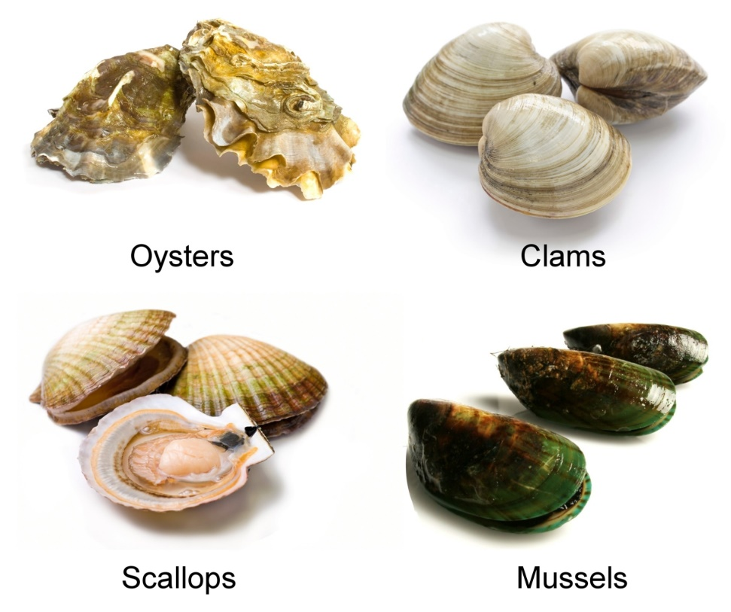
8. Molluscs
Molluscs include mussels, oysters, squid and octopus
Mollusc allergy symptoms can be quite severe
There is always high risk of cross contamination as they move through the supply chain

Slide 131
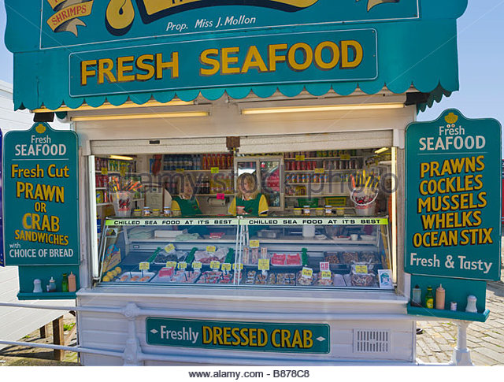
8. What to look for on the label
Snails
Squid
Scallops
Mussels
Clams
Cockles
Abalone
Mussels
Octopus
Oysters
Whelks

Slide 132
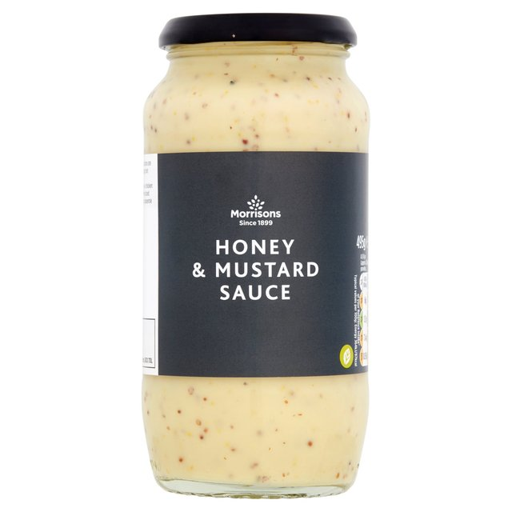
9. Mustard
Mustard allergy is likely to cause reactions from foods made from the mustard plant
This plant including the leaves, seeds and flowers
Mustard based oil
Foods that incorporate any of these.

Slide 133

9. What to look for on the label
Mustard powder
Mustard seeds
Mustard flour
Mustard leaves
Mustard oil
Sprouted mustard seeds

Slide 134

10. Peanuts
Peanuts are related to foods such as peas, beans and lentils
Peanut Allergy symptoms are normally mild
Extreme cases sometimes occur
Symptoms include:
  wheezing,
  swelling in the throat
  anaphylactic shock,
Although fatal symptoms rarely occur

Slide 135
10 What to look for on the label
Ground Nuts
Beer nuts
Monkey nuts
Nut meat
Arachis oil
Kernels
Peanut protein
Arachic oil
Arachis
Arachis hypogaea
Artificial nuts
Boiled peanuts
Cold pressed
Extruded/expelled peanut oil
Crushed nuts
Crushed peanuts
Earth nuts
Goober peas
Hydrolyzed peanut protein
Mandelonas
Nutmeat
Peanut butter
Peanut flour,
Peanut paste
Peanut sauce,
Peanut Syrup

Slide 136

11. Sesame
These are found commonly in bread
Sprinkled on buns such as hamburger buns
Also bread sticks, Houmous, sesame oil and tahini.

Slide 137

11 What to look for on the label
Sesame seeds
Sesame oil
Benne
Benne seed
Gingelly
Gingelly oil
Notes:
Pret a Manger's food labelling failed to warn a 15-year-old girl who died after eating one of its baguettes that the sandwich contained allergens, an inquest has heard.
Concluding the hearing into the death of Natasha Ednan-Laperouse, coroner Dr Sean Cummings recorded a narrative verdict, finding that the teenager was "reassured" by the lack of specific warnings on the packaging.
"Natasha Ednan-Laperouse died of anaphylaxis in Nice on July 17, 2016, after eating a baguette purchased from Pret a Manger at London Heathrow's Terminal 5," he said.
"The baguette was manufactured to Pret specifications and contained sesame to which she was allergic.

Slide 138
The menu of forgetfulness Part 2

Slide 139
The Menu of Forgetfulness
The person responsible for labelling the allergens on the menu items has forgotten to do them.
Working in Pairs can you put in the correct allergens for today and tomorrow’s menus
Just put in Gluten, Lupin, Milk, Molluscs, and Mustard for now.

Slide 140
This list Jesus College uses
If colleges have their own codes participants should use the one they are most familiar with.
Notes:
This is the list Jesus College uses. If colleges have their own codes then they should use the one they are most familiar with

Slide 141

It Should look like this
Notes:
Jesus College

Slide 142

12. Soya
Soya is a common ingredient in many of todays foods
The beans can be eaten fresh, dried or made into soya flour
The flour is often found in bread and baked goods
Soya allergy is quite rare in the UK compared with all the other main allergens

Slide 143
12 What to look for on the label
Soy flour
Soya Milk
Soya nuts
Bean curd
Edamame (soybeans in pods)
Hydrolyzed soy protein
Kinnoko flour
Kyodofu (freeze dried tofu)
Miso
Natto
Okara (soy pulp)
Shoyu sauce
Soy albumin,
Soy concentrate
Soy fiber
Soy formula
Soy grits
Soy milk
Soy miso
Soy nuts
Soy nut butter
Soy protein
Soy protein concentrate,
Soy protein isolate
Soy sauce
Soy sprouts
Soya

Slide 144
12 What to look for on the label
Soya flour,
Soybeans
Soybean granules
Soybean curd
Soybean flour
Soy lecithin
Soybean paste
Supro
Tamari
Tempeh
Teriyaki sauce
Textured soy flour (TSF)
Textured soy protein (TSP)
Textured vegetable protein (TVP)
Tofu
Yakidofu
Yuba (bean curd)
Soy oil
Soybean
Textured vegetable protein
Vegetable starch
Vegetable gum

Slide 145

13. Sulphites
Sulphites are preservatives used in the production of some foods and drinks
Sulphite allergy is quite rare
More prevalent in people who suffer with asthma
Reactions can cause wheezing and coughing
Severe symptoms are rare
Notes:
The cake contains dried fruit. Dried fruits are often preserved using sulphites.

Slide 146

13 What to look for on the label
Sulphur
Sulphur Dioxide
Sulphite
Sulphites
Potassium bisulphite
Metabisulphite
Sodium bisulphite
Dithionite
Metabisulphite
Sulphiting agents
Sulphurous acid
E220 Sulphur dioxide
E221 Sodium sulphite
E222 Sodium hydrogen sulphite
E223 Sodium metabisulphite
E224 Potassium metabisulphit
E226 Calcium sulphite
E227 Calcium hydrogen sulphite
E228 Potassium hydrogen sulphite
E150b Caustic sulphite caramel
E150d Sulphite ammonia caramel
Notes:
Full of yummy goodness!

Slide 147

14. Tree Nuts
Tree nut allergy can affect many people with peanut allergy
Some people allergic to one tree nut, can become allergic to other tree nuts
Nuts are in many products
The possibility of cross contamination during food production can occur

Slide 148

14 What to look for on the label
Almonds
Hazelnuts
Walnuts
Cashews
Pecan Nuts
Brazil Nuts
Pistachio Nuts
Macadamia Nuts

Slide 149
The menu of forgetfulness Part 3

Slide 150
The Menu of Forgetfulness
The person responsible for labelling the allergens on the menu items has forgotten to do them.
Working in Pairs can you put in the correct allergens for today and tomorrow’s menus
Just put in Peanuts, Sesame, Soy Sulphites and Tree Nuts

Slide 151
This list Jesus College uses
If colleges have their own codes participants should use the one they are most familiar with.
Notes:
This is the list Jesus College uses. If colleges have their own codes then they should use the one they are most familiar with

Slide 152

It Should look like this

Slide 153
Other Allergens
Allergens covered by the are the top 14.
There are others you may know of including:
Rice
Mushrooms
Strawberries
Cotton
Avocados
Beer
Penicillin
Latex

Slide 154
Adapting and changing
Case Studies

Slide 155

Cases Studies
Here are our six students again
In this session we would like you to adapt and change the meals so that they are nutritionally balanced and appropriate to their ethical, religious and now therapeutic needs
Notes:
The next section is case studies.

Slide 156
Thank You
Final Questions
Notes:
Any feedback from the course will be included in a tweaked version on the USB Stick you will get next week.

